Slide 1


WK21: An introduction to estimating ecological change with the USDA Forest Service FIA Database

Slide 2





Jane Terzibashian
Supervisory Biological Scientist
USDA Forest Service
jane.terzibashian@usda.gov
Bailey McLaughlin
PhD Candidate
University of Maine
bailey.mclaughlin@maine.edu
Daniel (Donny) Perret
ORISE Postdoctoral Fellow
USDA Forest Service
daniel.perret@usda.gov
Harold Zald
Research Ecologist
USDA Forest Service
harold.zald@usda.gov

Slide 3
Workshop goal:
Provide a basic introduction to the Forest Inventory and Analysis database, with the goal of easing the initial learning curve.
Part I
FIA program background
Part II
Linking tables and querying data
Part III
Intro to change estimation
Part IV
Common pitfalls and ways forward

Slide 4
Disclaimers!
We’re not trying to provide a comprehensive course in the analysis of FIA data – we only have 90 minutes!
We’re database users ourselves, but not analysis super-wizards. While we have experience navigating and using the data, we don’t have all the answers. Part of this workshop is helping you find the resources necessary to answer all the thorny questions!
Always consult the User Guide, Estimation Guide, and other USFS resources. Sometimes there are no shortcuts, you gotta wade through the manual.

Slide 5

Workshop resources
GitHub repository with slides, data, code, and documents:
https://github.com/daniel-perret/FIA-workshop-ESA2023
Look! A QR code!
FIA documentation:
https://www.fia.fs.usda.gov/library/database-documentation/#FIADB
FIA User Guide (Phase 2, Version 9.0.1):
https://www.fia.fs.usda.gov/library/database-documentation/current/ver90/FIADB%20User%20Guide%20P2_9-0-1_final.pdf
Population Estimation User Guide:
https://www.fia.fs.usda.gov/library/database-documentation/current/ver90/FIADB%20User%20Guide%20P2_9-0-1_final.pdf

Slide 6

Section I: Forest Inventory & Analysis: Program Background
Photo credit: Emily Giovannozzi

Slide 7

Acknowledgements & references
Section 1 of this presentation was compiled for ESA 2023 heavily borrowing from:
Our Legacy: a history of FIA by Glenn Christensen prepared for 2016 PNW FIA field crew training
FIA 101: a self-study course and reference guide for Forest Inventory and Analysis (FIA) staff and aspiring data users. Version 1 (2019). Produced by Rocky Mountain Research Station, Inventory and Monitoring Program. Content created by Rachel Simons, Jeremy Morrone, Drew Narduzzi, and Whitney Burgess under the direction of Steering Team: Tracey Frescino, Sara Goeking, Jim Menlove, Maryfaith Snyder, and many others.
Forest Inventory and Analysis: past to present for Auburn University FORY3180 Southern Research Station, Forest Inventory and Analysis Program produced by KaDonna Randolph, Andy Hartsell, Tom Brandeis, Todd Schroeder, and Robert Lee.
PNW FIA field crew contributed photos!
Photo credit: Emily Giovannozzi

Slide 8
What we’ll cover in this section:
(a) What is FIA? A brief origin story:
Program roots in timber resource accounting, congressional mandates, and where we are now
(b) FIA design fundamentals:
Grid to ground; what you need to know about scale and time
(c) The FIA plot and protocol:
Plot layout, what is measured and where
(d) How data are collected: hometown examples from PNW-FIA

Slide 9
(a) FIA: a brief origin story
McSweeney-McNary Forest
Research Act of 1928 (P.L. 70-466)
directed the Secretary of
Agriculture to make:
“… a comprehensive survey of
the present and prospective
requirements for timber and
other forest products of the
United States…”.
The Forest Inventory and Analysis (FIA) research program has been in existence since mandated by Congress in 1928.
FIA's primary objective to determine the extent, condition, volume, growth, and use of trees on the Nation's forest land spanning all ownership.

Slide 10
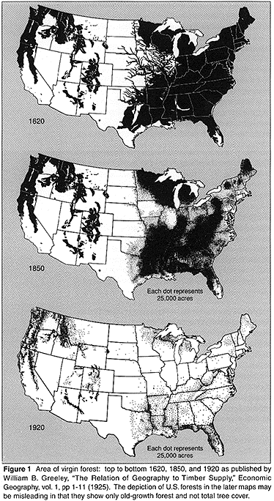
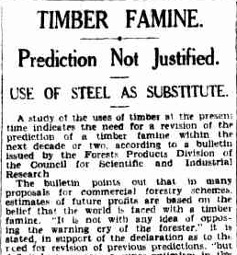
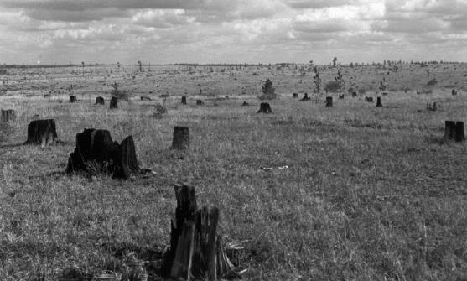
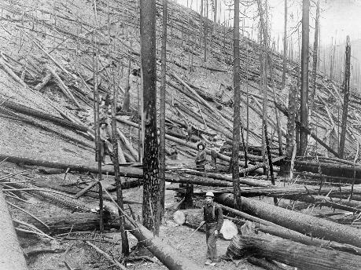
(a) FIA: a brief origin story
(a) FIA: a brief origin story
Early 1900’s the US timber supply estimated between 400 billion board feet and 530 billion board feet (1910)... But no one really knew?

Slide 11
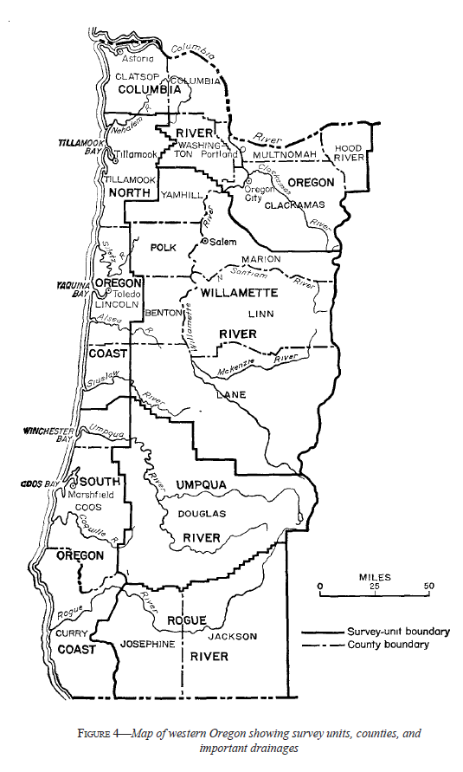

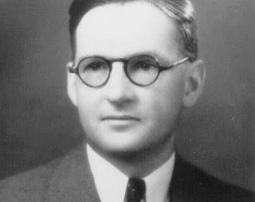
(a) FIA: a brief origin story
YOU ARE HERE
In 1929 PNW Research Station Director
Thorton Munger convinces Chief to begin
the survey in Oregon/Washington
HJ Andrews hired to begin the inventory
He started right around Portland in 1930

Slide 12
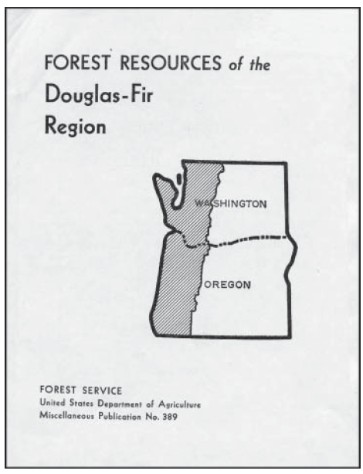
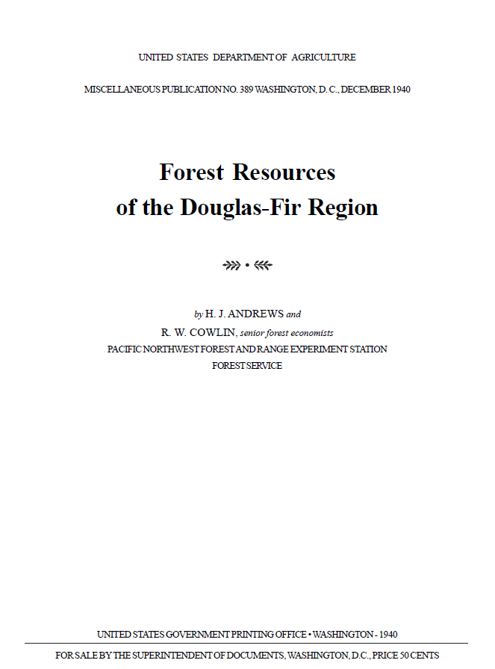
(a) FIA: a brief origin story
Remember the 1909/1910 estimate of total wood in the US, est. about 400-500 billion board feet?
HJ Andrews survey estimated that within the combined region of western OR and WA, there was 546 billion board feet of timber. 60% of this is in Douglas-fir.

Slide 13
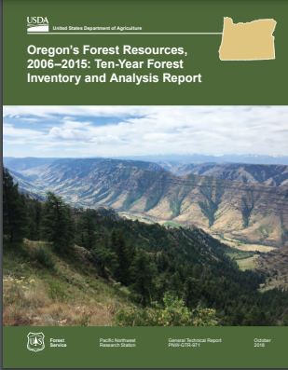
(a) FIA: a brief origin story
Inventories originally focused on tracking timber supply - now include soils, wildlife habitat…
Early protocols varied across the nation to suit the needs of different regions – this changed with the 1998 Farm Bill, mandated a nationally uniform plot and grid design.
The forest commodity aspects of FIA combined with forest health monitoring’s annual inventory design and objectives.
The most recent Congressional directives are Urban FIA, integrate technologies such as remote sensing, and report on biomass and carbon stocks.

Slide 14
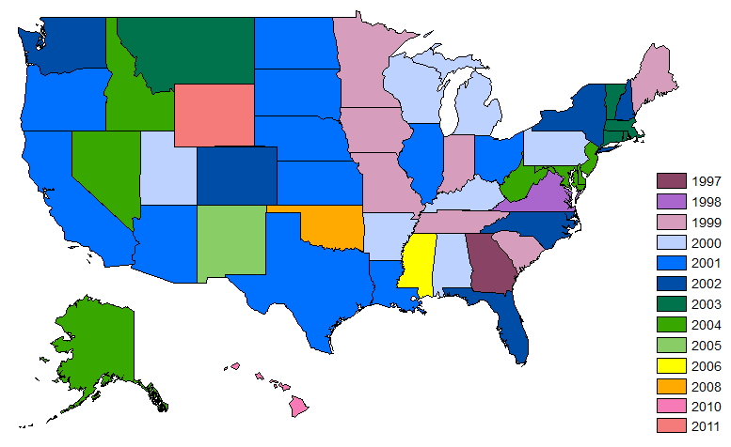
(a) FIA: a brief origin story
Implementation Year for FIA Annual Inventory in the United States
The Enhanced FIA Program or more commonly as the “annual inventory” was gradually implemented across the United States.
2002
2003
2001
1999
2003
1999
2001
2001
2000
2004
2011
2000
2002
2001
1999
2002
1999
2001
2000
2003
2004
2000
2002
2001
2001
1999
2004
2004
2000
1998
2001
1999
2002
2008
2000
2001
2005
1999
2006
2000
1997
2001
2001
2002
2004
2010
Forest Inventory and Analysis: past to present

Slide 15
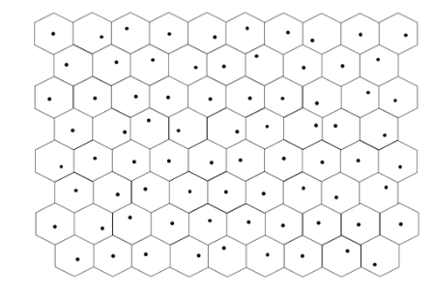
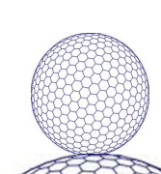
(b) FIA: design fundamentals
FIA uses a semi-systematic sample (plot data) to describe an area (the population)
a random sample applied to a systematic grid
FIA grid is a lattice of hexagons (a sphere can elegantly be dividend into hexagons of equal area)
Each hex represents ~6,000 acres
Centroids of hexagons are ~3 miles apart
More than FIA 360,000 hexagons across the US
Not every plots is visited every year – broken into “panels”, ex. 10 panels means 10% of the plots visited (unclumped) each year and in 10 years the cycle is complete.
Some states have 5yr -cycles, 7, 10…

Slide 16
(b) FIA: design fundamentals
The estimates are an approximation of an attribute of interest with an upper and lower bound, for a population with a known area.
FIA describes over 2,600 attributes!
Some on all forestland plots (forest area, number of trees…). Others are available only when a plot is sampled twice (e.g. average annual mortality of trees)
What is found on a set of plots are then aggregated and then expanded to allow estimates for a much larger area including a measure of uncertainty.

Slide 17
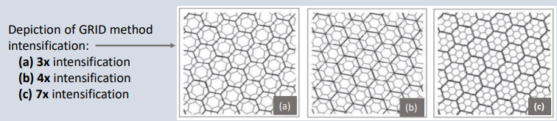
(b) FIA: design fundamentals
The inventory was designed to achieve mandated accuracy standards at the state level. The standard distribution of plot locations, about one plot per 6000-acre hexagon, makes analysis of areas smaller than a survey unit more difficult.
Plot grid intensification – the addition of plots in a systematic fashion is possible
It is important to examine the standard error and number of plots associated with FIA estimates, especially for attributes of limited extent such as
Individual or small groups of counties
Rare species or forest types
Specific age or stand-size classes

Slide 18
(c) FIA: plot and protocol
FIA Data Table Structure
FIA employs multiple sampling strategies to answer questions about forest land, the forest products industry, and forest landowners.
To describe forest land, FIA collects > 300 variables via remote sensing and field inventories.
Fixed Radius Plot Design
Monumented/recorded to relocate and remeasure individual trees over time
Nationally standardized core variables + core optional and regional data items

Slide 19
(c) FIA: plot and protocol
FIA Data Table Structure
Macroplot:
58.9 ft radius
Subplot:
24.0 ft radius
2
Subplot (trees 5”+dbh: crowns, damage, mortality, and understory vegetation)
Macroplot (site info, disturbances, forest type, stand structure, stand age. Optional large tree inventory>24” or 32”dbh )
Distance between subplot centers is 120.0 ft horizontal
1
Microplot (seedlings and saplings 1-5”dbh)
4
3
Transect lines (down woody material, fuels, residue piles, ground layer)
Microplot:
6.8 ft radius center is 12.0 ft horizontal at 90ºazimuth from the subplot center
Optional transect lines (down woody material, soils and fuels)

Slide 20
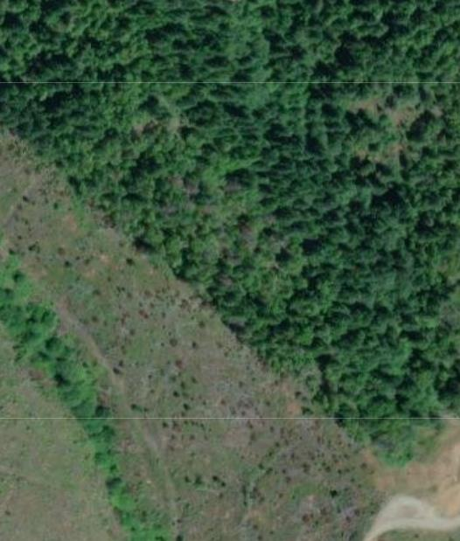
(c) FIA: plot and protocol
FIA Data Table Structure
2
Within a plot we have protocol to lump or split area into “conditions” and may map them out.
A condition class is the combination of discrete landscape and forest attributes that identify, define and classify the area associated within a plot.
Must be DIFFERENT enough.
1
4
3

Slide 21
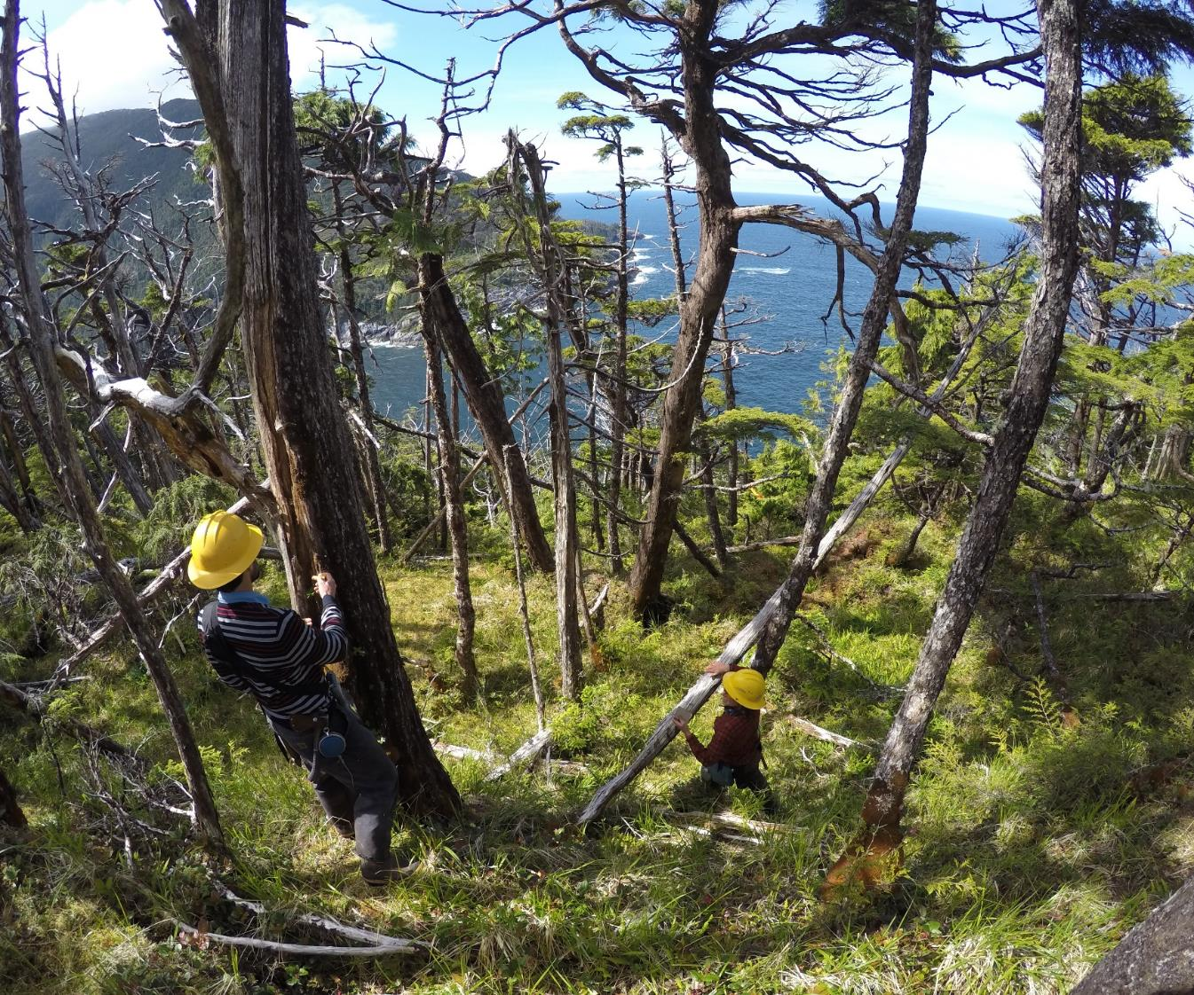
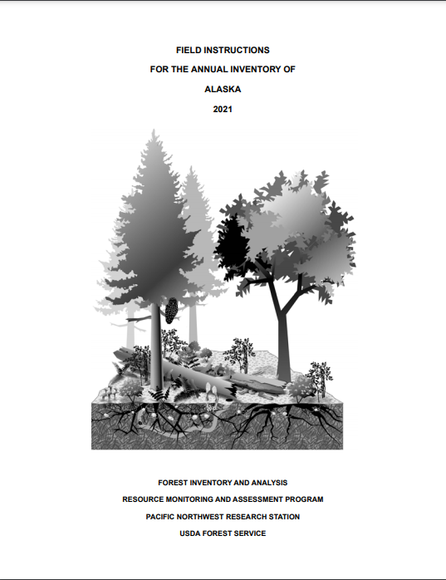
(c) FIA: plot and protocol
What data are collected? and how?
Some FIA
units have
416
pages of
field
protocol!

Slide 22



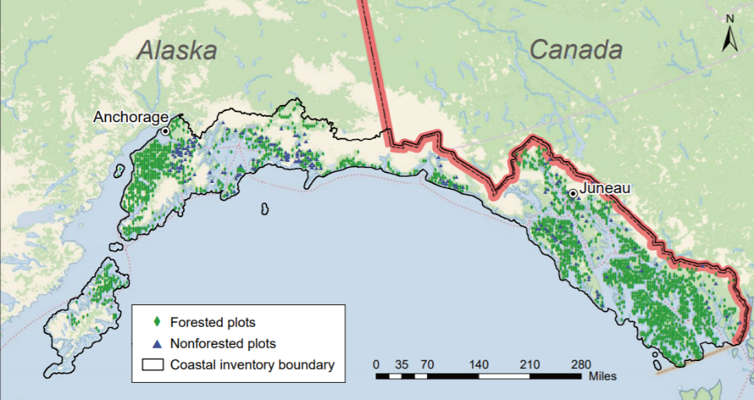
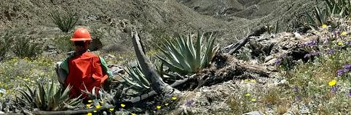
(d) FIA: how data are collected

Slide 23
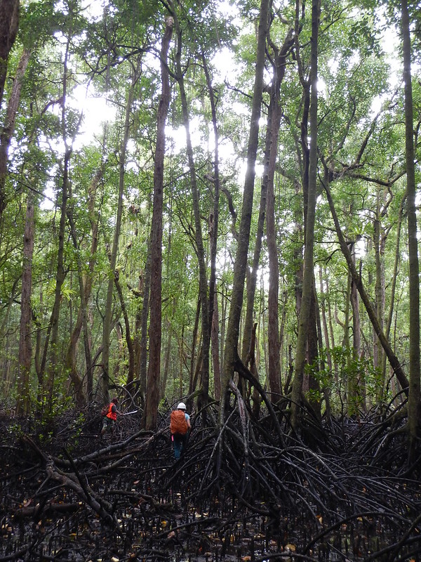
(d) FIA: how data are collected

Slide 24

(d) FIA: how data are collected
In contrast to attributes that are observed and classified directly in the field others are computed
Some attributes are computed at the tree level; some are computed at the condition-class or plot level.
Computed attributes can be:
the measures upon which population estimates are based (e.g., acres, numbers of individuals, and volume)
used to specify domains (placement of continuous variables into discrete classes (e.g., volume-per-acre class) in order to estimate the area in each class).
Some attributes are computed in addition to being observed directly (i.e., forest type and stand size), so these have both field-assigned and computed values.

Slide 25
(d) FIA: how data are collected

Slide 26

Section II: Working with the FIA Data
Section II:
Working with the FIA Data

Slide 27
What we’ll cover in this section:
(a) FIA data table structure:
Conceptual overview of database structuring and table linkages
(b) How and where to access FIA data:
Data mart downloads from FIA webpage and/or direct R read-ins
(c) FIA tables of ecological relevance:
Introduction to some tables of particular relevance and their available data
(d) Example, linking tables for analysis:
Operationalizing the conceptual linkages, in R!

Slide 28
(a) FIA Data Table Structure
FIA Data Table Structure
FIA is a relational database structure.
Multiple distinct tables contain their own unique sets of information.
These tables can be linked together via unique identifiers.
There are 50+ tables per state, with dozens to hundreds of measured and/or computed variables available in each.
At the outset of a project, (1) determining which data (and therefore which tables) are needed, and then (2) accurately linking tables is important.
Let’s take a look…

Slide 29
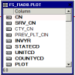
(a) FIA Data Table Structure
FIA Data Table Structure
Example table relationships,
visualized from FIA:
FIA Database Description and User Guide for Phase 2 (version 9.0.1), 2021

Slide 30
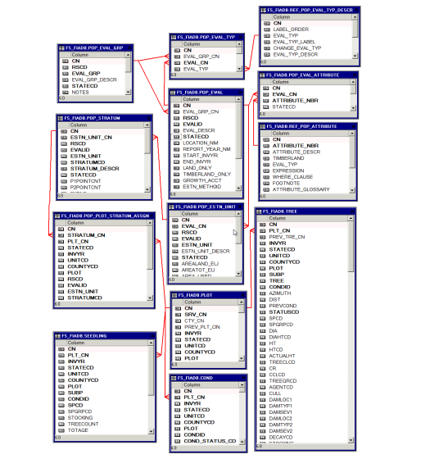
(a) FIA Data Table Structure
FIA Data Table Structure
Example table relationships,
visualized from FIA:
FIA Database Description and User Guide for Phase 2 (version 9.0.1), 2021

Slide 31
(a) FIA Data Table Structure
FIA Data Table Structure
Data tables (boxes with blue headings)
REMINDER!
This is a subset of all available information! There are 50+ tables per state and several reference tables.
Data columns representing variables collected (black text within box)
Linkages between distinct tables (red lines between boxes)
FIA Database Description and User Guide for Phase 2 (version 9.0.1), 2021

Slide 32
(a) FIA Data Table Structure
FIA Data Table Structure
REF_SPECIES
SPCD
FIA Database Description and User Guide for Phase 2 (version 9.0.1), 2021

Slide 33
(a) FIA Data Table Structure
Example table
relationships,
Simplified subset
Adapted from: FIA Database Description and User Guide for Phase 2 (version 9.0.1), 2021

Slide 34
(a) FIA Data Table Structure
Adapted from: FIA Database Description and User Guide for Phase 2 (version 9.0.1), 2021

Slide 35
(a) FIA Data Table Structure
Adapted from: FIA Database Description and User Guide for Phase 2 (version 9.0.1), 2021

Slide 36
(a) FIA Data Table Structure
Adapted from: FIA Database Description and User Guide for Phase 2 (version 9.0.1), 2021

Slide 37
(a) FIA Data Table Structure
Conceptual overview of table
relationships:

Slide 38
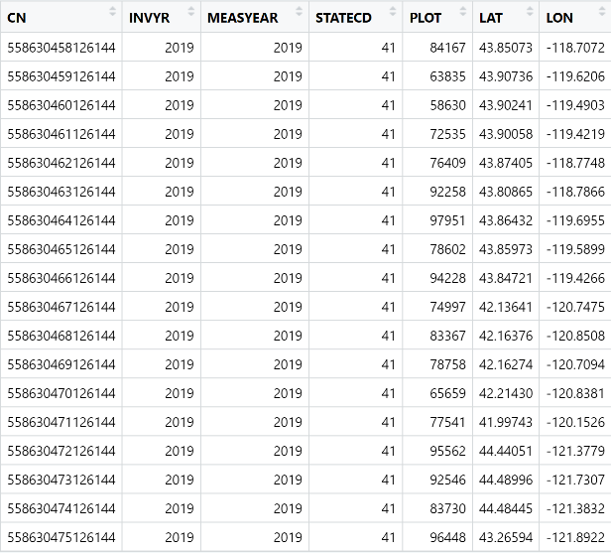
(a) FIA Data Table Structure
Conceptual overview of table
relationships:
Example table (PLOT) in tabular format:

Slide 39
(a) FIA Data Table Structure
Summary Points:
Consider your research question. Then ask:
(1) What data will you need to answer it?
(2) What tables in the FIA database have that data?
(3) How do these tables link together?

Slide 40
(a) FIA Data Table Structure
Summary Points:
Consider your research question. Then ask:
(1) What data will you need to answer it?
(2) What tables in the FIA database have that data?
(3) How do these tables link together?
Be considerate about: What you need, where to find it, and how to accurately access it.
Let’s talk more about how, specifically, to achieve this!

Slide 41
(a) FIA Data Table Structure
Summary Points:
Consider your research question. Then ask:
(1) What data will you need to answer it?
(2) What tables in the FIA database have that data?
(3) How do these tables link together?
Be considerate about: What you need, where to find it, and how to accurately access it.
Let’s talk more about how, specifically, to achieve this!
*Annnnd…FIA has summarized the database information in various ways already, to preempt some common questions. Familiarize yourself with the many resources available!

Slide 42
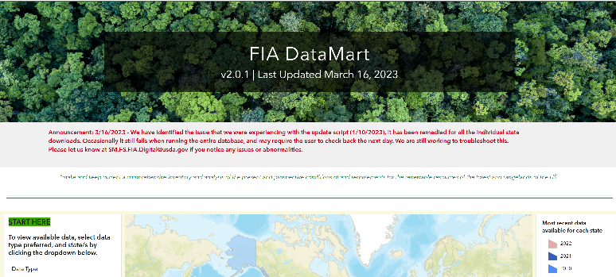
(b) How and Where to Access FIA Data
https://apps.fs.usda.gov/fia/datamart/datamart.html

Slide 43
(b) How and Where to Access FIA Data
FIA DataMart Download:
(1) Select preferred data format (XLSM, CSV, SQLite, Zip),
select state(s) of interest,
select data table(s) needed,
download!
~ Let’s look at an example! ~

Slide 44
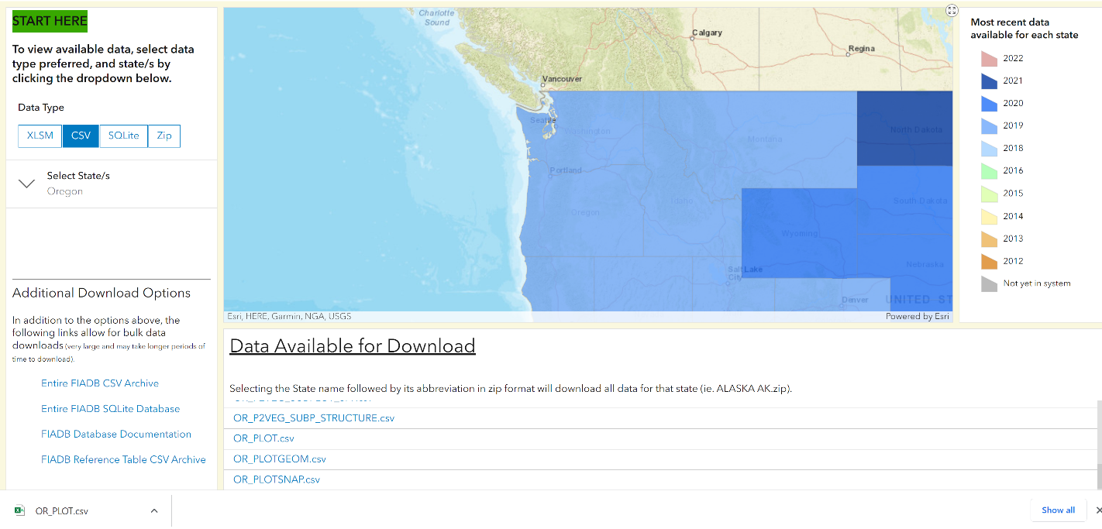
(b) How and Where to Access FIA Data
Example: PLOT data in .csv format for the state of Oregon, direct from DataMart webpage
.csv file format
Oregon selected
PLOT table available
Oregon PLOT table downloaded as .csv

Slide 45
(b) How and Where to Access FIA Data
Example: PLOT data in .csv format for the state of Oregon, downloaded in R

Slide 46
(b) How and Where to Access FIA Data
Summary Points:
Different options for getting data downloaded onto your machine (direct versus R versus others!).
Considerations when downloading data:
What variables to include. Might not need/want all available.
Year ranges of data to download.
Multi-state downloads.
Bulk downloads (i.e. all PLOTs).
Archive the version of the data when you download it, updates frequently!
…the database is huge and there’s a lot you can do with it!

Slide 47
(c) FIA Tables of Ecological Relevance
The PLOT table contains information about all plots in each state, for which various ground measurements are taken.
Available data include: fuzzed/swapped plot coordinates, state information, year representing when data was collected.

Slide 48
(c) FIA Tables of Ecological Relevance
The TREE table contains information for all tree-level measurements taken for those individual trees surveyed on each plot.
Available data include: size, species, live/dead status, agent of mortality, damage codes, disturbance codes etc.

Slide 49
(c) FIA Tables of Ecological Relevance
The SEEDLING table contains information about seedlings found on plots.

Slide 50
(c) FIA Tables of Ecological Relevance
The REF_SPECIES table allows species codes to be matched to species scientific and common names, to identify the trees/seedlings encountered.

Slide 51
(c) FIA Tables of Ecological Relevance
The COND table provides information about, essentially, the habitat conditions encountered on a plot. Note: there can be multiple “conditions” found on a single plot.

Slide 52
(d) Example, Linking Tables for Analysis
…jumping to R!

Slide 53

Section III: A (brief) introduction to change estimation

Slide 54
Caveats!
This is just a basic introduction to some of the nuance involved!
I don’t know all the answers!
Always consult the User Guide and the Estimation Guide!

Slide 55



TIME 1

Slide 56


TIME 1
5 live trees

Slide 57

TIME 1
5 live trees
1 standing dead

Slide 58

TIME 1
5 live trees
1 standing dead
TIME 2

Slide 59
TIME 1
5 live trees
1 standing dead
TIME 2
6 live trees

Slide 60
TIME 1
5 live trees
1 standing dead
TIME 2
6 live trees
2 standing dead

Slide 61
Net change approach:
T2 – T1 = Change

Slide 62
Net change approach:
T2 – T1 = Change
6 live trees – 5 live trees = + 1 live tree (+20%)
2 dead trees – 1 dead tree = + 1 dead tree (+100%)

Slide 63
Net change approach:
simple
low data requirements
can be leveraged at scale

Slide 64
Net change approach:
simple
low data requirements
can be leveraged at scale
doesn’t reflect underlying ecological processes!
susceptible to data biases

Slide 65
GROWTH

Slide 66
REMOVAL

Slide 67
MORTALITY

Slide 68


(RECRUITMENT)

Slide 69
Tracking individual trees allows us to identify
GRM components
to gain insight into
how and why
change occurred

Slide 70
Tracking individual trees allows us to identify
GRM components
to gain insight into
how and why
change occurred
→ Chapter 7 of Population Estimation User Guide

Slide 71
How do we identify which trees form each component?

Slide 72
How do we identify which trees form each component?
LONG ANSWER:
Combining variables from the TREE table
SHORT ANSWER:
FIA does it for you!

Slide 73
LONG ANSWER:
Combining variables from the TREE table
SEEDLING
CN
COND
PLT_CN
CN
INVYR
REF_SPECIES
PLT_CN
PLOT
INVYR
PLOT
SUBP
SPCD
CONDID
CN
CONDID
COMMON_NAME
COND_STATUS_CD
INVYR
SPCD
GENUS
STATECD
SPECIES
PLOT
SPECIES_SYMBOL
LAT
LON
TREE
CN
PLT_CN
INVYR
SUBP
PLOT
TREE
STATUSCD
SPCD
DIA

Slide 74
LONG ANSWER:
Combining variables from the TREE table
SEEDLING
CN
COND
PLT_CN
CN
INVYR
REF_SPECIES
PLT_CN
PLOT
INVYR
PLOT
SUBP
SPCD
CONDID
CN
CONDID
COMMON_NAME
COND_STATUS_CD
INVYR
SPCD
GENUS
STATECD
SPECIES
PLOT
SPECIES_SYMBOL
LAT
LON
TREE
CN
PLT_CN
INVYR
SUBP
PLOT
TREE
STATUSCD
SPCD
DIA

Slide 75
LONG ANSWER:
Combining variables from the TREE table
SEEDLING
CN
COND
PLT_CN
CN
INVYR
REF_SPECIES
PLT_CN
PLOT
INVYR
PLOT
SUBP
SPCD
CONDID
CN
CONDID
COMMON_NAME
COND_STATUS_CD
INVYR
SPCD
GENUS
STATECD
SPECIES
PLOT
SPECIES_SYMBOL
LAT
LON
TREE
PREV_PLT_CN
CN
PLT_CN
INVYR
SUBP
PLOT
TREE
STATUSCD
SPCD
DIA
PREV_TRE_CN
PREV_STATUS_CD
PREVDIA
AGENTCD
RECONCILECD

Slide 76
LONG ANSWER:
Combining variables from the TREE table
SEEDLING
CN
COND
PLT_CN
CN
INVYR
REF_SPECIES
PLT_CN
PLOT
INVYR
PLOT
SUBP
SPCD
CONDID
CN
CONDID
COMMON_NAME
COND_STATUS_CD
INVYR
SPCD
GENUS
STATECD
SPECIES
PLOT
SPECIES_SYMBOL
LAT
LON
TREE
PREV_PLT_CN
CN
PLT_CN
INVYR
SUBP
PLOT
TREE
STATUSCD
SPCD
DIA
PREV_TRE_CN
PREV_STATUS_CD
PREVDIA
AGENTCD
RECONCILECD

Slide 77
LONG ANSWER:
Combining variables from the TREE table
TREE
CN
PLT_CN
INVYR
SUBP
PLOT
TREE
STATUSCD
SPCD
DIA
PREV_TRE_CN
PREV_STATUS_CD
PREVDIA
AGENTCD
RECONCILECD

Slide 78
Growth trees
LONG ANSWER:
Combining variables from the TREE table
TREE
CN
PLT_CN
INVYR
SUBP
PLOT
TREE
STATUSCD
STATUSCD = 1
Indicates a that tree survived between plot remeasurements
SPCD
DIA
PREV_TRE_CN
PREV_STATUS_CD
PREVDIA
AGENTCD
RECONCILECD
PREV_STATUS_CD = 1

Slide 79
Recruitment trees
LONG ANSWER:
Combining variables from the TREE table
TREE
CN
PLT_CN
INVYR
SUBP
PLOT
TREE
Indicates a new live tree that entered the population between remeasurements
STATUSCD
STATUSCD = 1
SPCD
DIA
PREV_TRE_CN
PREV_STATUS_CD
PREVDIA
AGENTCD
RECONCILECD
PREV_STATUS_CD = NA
RECONCILECD = 1, 2

Slide 80
Mortality trees
LONG ANSWER:
Combining variables from the TREE table
TREE
CN
PLT_CN
INVYR
SUBP
PLOT
TREE
Indicates a tree was alive at time 1, but died due to non-harvest-related causes by time 2
STATUSCD
STATUSCD = 2
SPCD
DIA
PREV_TRE_CN
PREV_STATUS_CD
PREVDIA
AGENTCD
RECONCILECD
PREV_STATUS_CD = 1
AGENTCD != 80

Slide 81
Removal trees
LONG ANSWER:
Combining variables from the TREE table
TREE
CN
PLT_CN
INVYR
SUBP
PLOT
TREE
Indicates that tree was alive at time 1, but had been removed by harvest or landclearing by time 2
STATUSCD
STATUSCD = 2, 3
SPCD
DIA
PREV_TRE_CN
PREV_STATUS_CD
PREVDIA
AGENTCD
RECONCILECD
PREV_STATUS_CD = 1
AGENTCD = 80
NOTE: Removal also formally includes trees removed from estimation population by diversion (forest to timberland transition; or definitional change between manuals)

Slide 82
How do we identify which trees form each component?
LONG ANSWER:
Combining variables from the TREE table
SHORT ANSWER:
FIA does it for you!

Slide 83
SHORT ANSWER:
FIA does it for you!
SEEDLING
CN
COND
PLT_CN
CN
INVYR
REF_SPECIES
PLT_CN
PLOT
INVYR
PLOT
SUBP
SPCD
CONDID
CN
CONDID
COMMON_NAME
COND_STATUS_CD
INVYR
SPCD
GENUS
STATECD
SPECIES
PLOT
SPECIES_SYMBOL
LAT
LON
TREE
CN
PLT_CN
INVYR
SUBP
PLOT
TREE
STATUSCD
SPCD
DIA

Slide 84
SHORT ANSWER:
FIA does it for you!
SEEDLING
CN
COND
PLT_CN
CN
INVYR
REF_SPECIES
PLT_CN
PLOT
INVYR
PLOT
SUBP
SPCD
CONDID
CN
CONDID
COMMON_NAME
COND_STATUS_CD
INVYR
SPCD
GENUS
STATECD
SPECIES
PLOT
SPECIES_SYMBOL
LAT
LON
TREE
CN
TREE_GRM_COMPONENT
PLT_CN
TRE_CN
INVYR
PLT_CN
SUBP
STEM_COMPONENT
PLOT
SUBP_COMPONENT_AL_FOREST
TREE
SUBP_TPA[*]_AL_FOREST
STATUSCD
SPCD
DIA

Slide 85


How do we use these change components?
Option 1:
Individual-based analysis

Slide 86
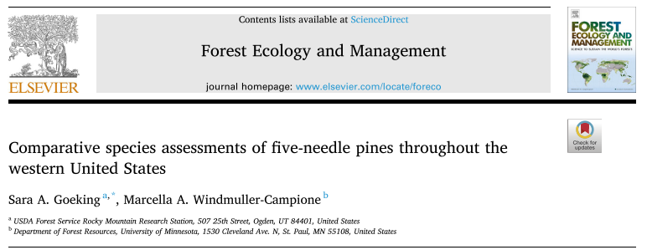
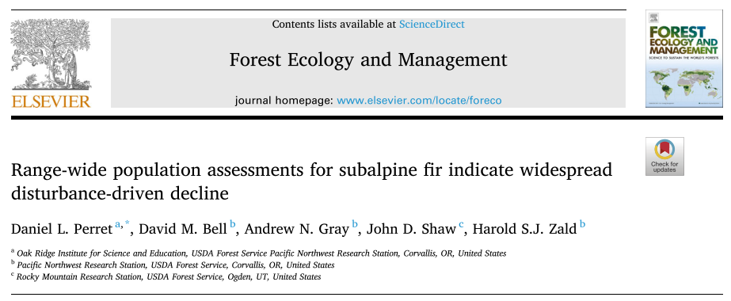
How do we use these change components?
Option 1:
Individual-based analysis
Option 2:
Population estimation

Slide 87
How do we use these change components?
Option 1:
Individual-based analysis
Option 2:
Population estimation
leverages FIA sampling design to make inference across large scales

Slide 88
Basic Estimation Approach
Identify GRM components
Get expansion factors for each component
Sum to the population of interest

Slide 89
Basic Estimation Approach
Identify GRM components
Get expansion factors for each component
In the TREE table, variable name “TPA_UNADJ”
Tells you how many trees per acre each tree on plot represents!
This is important because trees of different sizes are counted on plots of different sizes

Slide 90
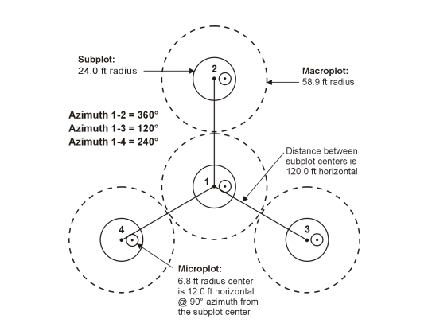
DBH ≥ 5”
DBH ≥ MACRO_BREAKPOINT_DIA
1”≤ DBH < 5”

Slide 91
5”≤ DBH < MACRO_BREAKPOINT_DIA
1 subplot = 1809.5574 sq ft
/ 43560 sq ft per acre = 0.04154172 acres
* 4 subplots per plot = 0.166167 acres
1 tree on subplot = 1/0.166167 acres
= 6.018046 trees per acre (TPA)

Slide 92
DBH ≥ 5”
DBH ≥ MACRO_BREAKPOINT_DIA
TPA_UNADJ
Subplot = 6.018046
Microplot = 74.965282
Macroplot = 0.999188
1”≤ DBH < 5”

Slide 93
DBH = 11”
subplot
DBH = 4”
DBH = 3”
DBH = 18”
microplot

Slide 94
6
6
--
75

Slide 95
6
6
75
6 + 6 + 75 = 87 trees per acre

Slide 96
6
DBH = 13”
6
DBH = 19”
DBH = 7”
75
6 + 6 + 75 = 87 trees per acre

Slide 97
6
6
6
6
6
75
6 + 6 + 75 = 87 trees per acre
6 + 6 + 6 = 18 trees per acre!

Slide 98
6
6
6
6
6
75
6 + 6 + 75 = 87 trees per acre
6 + 6 + 6 = 18 trees per acre!
Does a change of -69 trees per acre accurately reflect what happened here?

Slide 99
6
6
6
6
6
75
6 + 6 + 75 = 87 trees per acre
6 + 6 + 6 = 18 trees per acre!
The time-of-selection rule:
if a tree crosses a size threshold between plot types, use the expansion factor corresponding with the original plot type

Slide 100
6
6
6
6
75
75
6 + 6 + 75 = 87 trees per acre
6 + 6 + 75 = 87 trees per acre

Slide 101
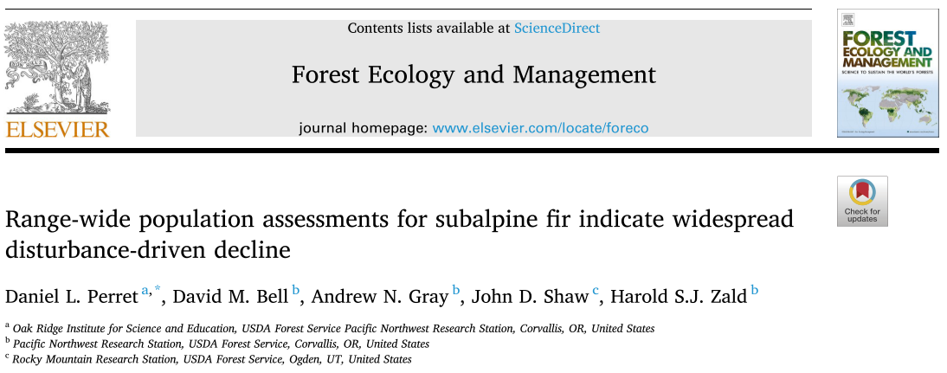
Example:
Estimating mortality, recruitment, and total abundance change of subalpine fir in Oregon

Slide 102

Section IV: Common pitfalls and ways forward

Slide 103
What we’ll cover in this section:
The FIA learning curve:
FIA scientist survey:
Survey response demographics:
Curated survey results:

Slide 104
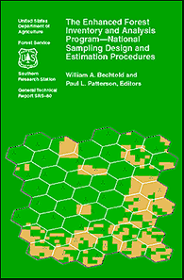
(a) The FIA Learning Curve
FIA Data Table Structure
Tremendous amount of data across ecological, spatial, and temporal domains.
As with any big complex relational dataset, multiple ways of learning to competently analyze FIA data.
Experience over time
Learning resources
FIA collaborators and expert knowledge

Slide 105
(b) FIA Scientist Survey
FIA Data Table Structure
Collaborations and expert knowledge take time.
To speed up the learning curve, we surveyed FIA scientists to learn what they thought were the common pitfalls and analytical ways forward across multiple ecological disciplines.
Carbon cycle
Forest health
Biogeography/species distribution modeling
Wildlife ecology
Disturbance ecology
Change estimation
Remote sensing applications
General advice and suggestions for new users

Slide 106
(c) Survey Response Demographics
FIA Data Table Structure
Internal survey via Microsoft Teams, 23 responses, 47-minute average response time

Slide 107
(d) Curated Survey Results: Carbon Cycle
FIA Data Table Structure
Be sure to understand how each carbon pool is measured and estimated.
Some pools like aboveground live tree carbon are fairly easy to estimate and already calculated in the FIADB, although some important assumptions (i.e. carbon as 50% of biomass).
Other pools like dead wood and soil carbon are less certain. For example, changing volume and density of dead wood.
Don't forget transfers between carbon pools, which gets back to understanding GRM tables, as well as carbon in harvested wood products.

Slide 108
(d) Curated Survey Results: Forest Health
FIA Data Table Structure
“Put on fuzzy glasses when interpreting tree damages. Think of damage types as a crappiness index rather than a definitive agent”
Need to consider timeframe when treating presence/absence of live tree damage codes (or mortality codes) as verified presence or absence, as a disease may not be observable over a 10-year remeasurement cycle, but it may still be present on a plot between measurements.
Think carefully about how questions and plot sample size interact. Select all stems of one specific species? only those in forested conditions? only those in fully forested plots? only those in specific forest types? only those in naturally regenerated conditions or planted/plantations?
Take the time to understand how FIA data collection protocols have changed over time with respect to tree damage and causal agents mortality.

Slide 109
(d) Curated Survey Results: Biogeography
FIA Data Table Structure
Non detection is an issue in relation to plot size, especially for understory vegetation as well as seedlings/saplings sampled on the much smaller microplot.
Be aware of which species are difficult to identify and distinguish, and examine the data closely in comparison to existing range maps to identify potential outliers before doing any modeling.
Phenology matters for species ID of understory vegetation. Best efforts are made to visit plots at phenologically appropriate times, but logistics and interannual climate variation.
Become familiar with the master species list and how it has changed over time.
Extra caution with species that hybridize in geographic areas. Consult with field staff before concluding the range for some of these species has shifted.

Slide 110
(d) Curated Survey Results: Wildlife Ecology
FIA Data Table Structure
Discipline with fewest comments in survey, due to far fewer examples in literature and not a primary objective within FIA program.
Habitat only since FIA doesn’t collect wildlife data.
Importance of spatial and temporal compatibility of wildlife species and plot data. Think ground dwelling beetles or small mammals versus wolverines.
Challenges deriving plot-level cover of understory or canopy vegetation for multi-condition plots.

Slide 111
(d) Curated Survey Results: Disturbance Ecology
FIA Data Table Structure
Tree-level versus condition class level. Disturbance data is observed by condition class, with different thresholds for different categories. Treatments are a kind of disturbance with different codes. Tree damage is coded for individual trees, and is not linked to condition class disturbance. Tree and condition class data can complement each other.
Be aware of regional differences in disturbance coding (example fire, surface fire, crown fire).
Consult the field guides to understand areal extent and proportional thresholds for disturbances and causal agents.
As with forest health comments, Need to consider timeframe when treating presence/absence of tree damage and mortality codes. Especially important with compound disturbance!

Slide 112
(d) Curated Survey Results: Change Estimation
FIA Data Table Structure
Watch out for definitional changes. Changes in key definitions (forest cover, trees) can result in incorrect change estimation.
Focus on GRM estimates and/or remeasured plots to estimate change, yet linking tables to only compare remeasured plots can be tricky.
Removals can be challenging for many new users, they includes trees which might still be alive and/or standing but are not in the sample or land use any more.
Read the Greenbook and work closely with a statistician who understands FIA GRM estimates and remeasured plots.
Run your own longitudinal consistency checks when using tree-level attributes.

Slide 113
(d) Curated Survey Results: Remote Sensing
FIA Data Table Structure
True plot locations are the elephant in the room. Don’t assume to can just request true plot locations, they are sensitive data, projects with them generally require collaboration with FIA scientists and a comprehensive data security plan.
Even for true plot locations, quality of geographic coordinates varies by region (although that is changing).
Make sure the spatial resolution of remote sensing data is comparable to plot footprint.
Consideration of whether or how to incorporate single vs. multi condition plots.
30 m

Slide 114
(d) Curated Survey Results: Other
FIA Data Table Structure
EVALIDator tool for generating reports with FIA data also provides SQL code
Take time to talk to a FIA data expert before you start your project or dive into analyses. They are super helpful and an amazing resource.
Collaborate with a FIA data expert.
Take the time to understand all the terminology and protocol, read through the manuals/instructions and then to not hesitate to reach out with clarifying questions.

Slide 115
Workshop resources
GitHub repository with slides, data, code, and documents:
https://github.com/daniel-perret/FIA-workshop-ESA2023
Look! A QR code!
We’re still actively compiling more resources! If you’d like to be notified about more FIA stuff, shoot one of us an email (subject line “FIA WORKSHOP”). Feel free to keep in touch with us and with each other as your FIA analyses develop!
daniel.perret@usda.gov
bailey.mclaughlin@maine.edu
jane.terzibashian@usda.gov
harold.zald@usda.gov

